Slide 1
Agenda for GEOG260/360 GIS & Land Change Models
October 2
See the interesting jobs in geographic modeling
Discuss Assignment 3 and literature that used TOC curves
Discuss Assignment 4
Get familiar with the Extract module
How do we interpret output numbers from a neural net?
October 4
Submit Assignment 4 by 4pm on Canvas
Get instructions for Assignment 5
October 9
No class
October 11
Tanner office hours in the Academic Commons 11am-1pm
Get instructions for Assignment 6
October 12
Tanner office hours in the Academic Commons 11am-1pm
October 13
Submit Assignment 5 by 4pm on Canvas
October 16
Discuss Assignment 6
October 18
Submit Assignment 6 by 4pm on Canvas
Get instructions for Assignment 7

Slide 2

https://workforcenow.adp.com/mascsr/default/mdf/recruitment/recruitment.html?cid=9a93435d-91d4-4a65-8a21-2de9187df1dd&ccId=19000101_000001&jobId=496602&lang=en_US

Slide 3

https://workforcenow.adp.com/mascsr/default/mdf/recruitment/recruitment.html?cid=9a93435d-91d4-4a65-8a21-2de9187df1dd&ccId=19000101_000001&jobId=495261&lang=en_US

Slide 5
Modeling Vocabulary
Sensitivity Analysis is the procedure to measure how the variation in model parameter(s) influences the model output. Modelers use sensitivity analysis to determine the parameters that have relatively more influence on the output compared to the parameters that have relatively less influence on the output. Sensitivity analysis is helpful when the modeler does not know the value(s) to use for the model parameter(s).

Slide 6
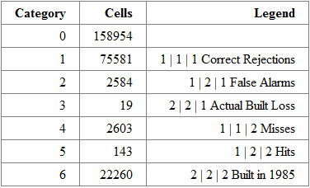
Run 1– For this run we set quantity to equal the validation map of 1999. This means that we are inputting the correct number of pixels that will change between 1985 and 1999, and asking the model to predict where the change will take place, which pixels will flip from non-built to built. The model only has a single driver image– land use in 1971, so when selecting pixels that are likely to change by 1999, it prioritizes land use types that had the highest built gain intensity between 1971 and 1985. However, the patterns of land use change seem to have changed in the more recent interval, as this method produces only 143 hits out of a total of 2746 pixels that changed (hits plus misses). However, the ratio between false alarms and misses is roughly 1:1 here (2584 vs 2603).

Slide 7
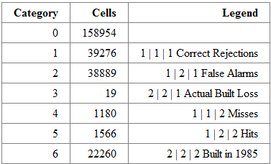
Run 2– For this run we set change quantity to 40456. This is equal to half of the total non-built pixels in 1985, and roughly 15 times the actual number that changed. The model only has a single driver image– land use in 1971, so when selecting pixels that are likely to change by 1999, it prioritizes land use types that had the highest built gain intensity between 1971 and 1985. However, the patterns of land use change seem to have changed in the more recent interval, as, even though the model was able to select 15x more pixels than actually changed, it only hit on 1566 out of a total of 2746 pixels that changed (hits plus misses). The ratio between false alarms and misses is roughly 33:1 here (38889 vs 1180), meaning that the model vastly over predicted. However, if you only looked at the ratio of hits (1566) to misses (1180), you might think that the model did a good job.

Slide 8
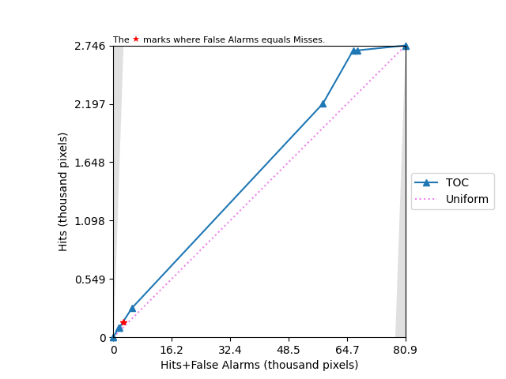
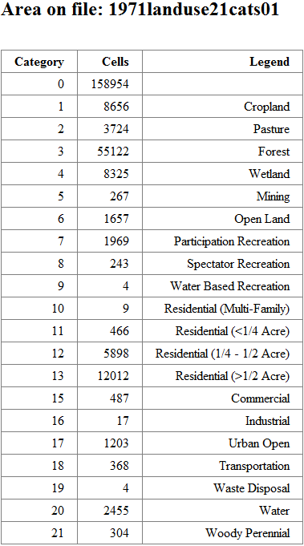
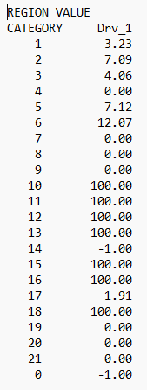
TOC Curve Explanation- The TOC graph below displays the gain intensity of each land cover type from 1971 that contributes to the 2746 pixels that changed from non-built to built from 1985 to 1999, as it relates to a theoretic run of geomod. The x axis represents the total number of pixels that were predicted to change– hits plus misses. In this case, the model is performing prediction on every non-built pixel in the baseline image. This will not usually be the case.
Each triangle along the blue line represents the threshold for a given land cover. They are ordered from left to right by gain intensity based on the 1971 land cover image, which was the sole driver for our Geomod runs. These intensities are listed in the LUB file below. The most important thing to observe is the slope of each line as it approaches each triangle. This indicates the built gain intensity for each starting land type. A steeper slope indicates that a higher percentage of pixels from that landcover type changed from non-built to built.
For example– the largest segment of blue line represents forest, comprising 55122 pixels. It rises at a slightly greater rate than the uniform slope, indicating that it is targeted at a higher rate than the overall rate of land change for all land cover types. It is interesting to note that the segment above it, representing gain intensity on cropland, is steeper than the segment below it. This shows that the land cover types were not targeted at the same rate across different temporal frames, ie non-stationarity. As it traverses the last couple triangles, the line flattens considerably, showing that the last two categories are targeted at very low rates, and account for little of the overall change. When the curve reaches the final triangle, at the upper right corner of the map, it has accounted for every pixel hit, and all the expository power of each land cover type.

Slide 9
Run 1
In Run 1, I used the 1999Built1.rst map as a validation map for the simulated change in built, using GeoMod. This validation map ensured that the quantity of cells simulated to experience change in built would match the actual change in built. When the correct quantity of land change is selected, False Alarms = Misses – Actual Built Loss, which is what can be seen in the table on the right.
Pixel Count by Category from the Validation Map (Run 1)
Category | Cells | Legend
0 | 158954 | 0 | 0 | 0 Mask
1 | 75581 | 1 | 1 | 1 Correct Rejections
2 | 2584 | 1 | 2 | 1 False Alarms
3 | 19 | 2 | 2 | 1 Actual Built Loss
4 | 2603 | 1 | 1 | 2 Misses
5 | 143 | 1 | 2 | 2 Hits
6 | 22260 | 2 | 2 | 2 Built at 1985

Slide 10
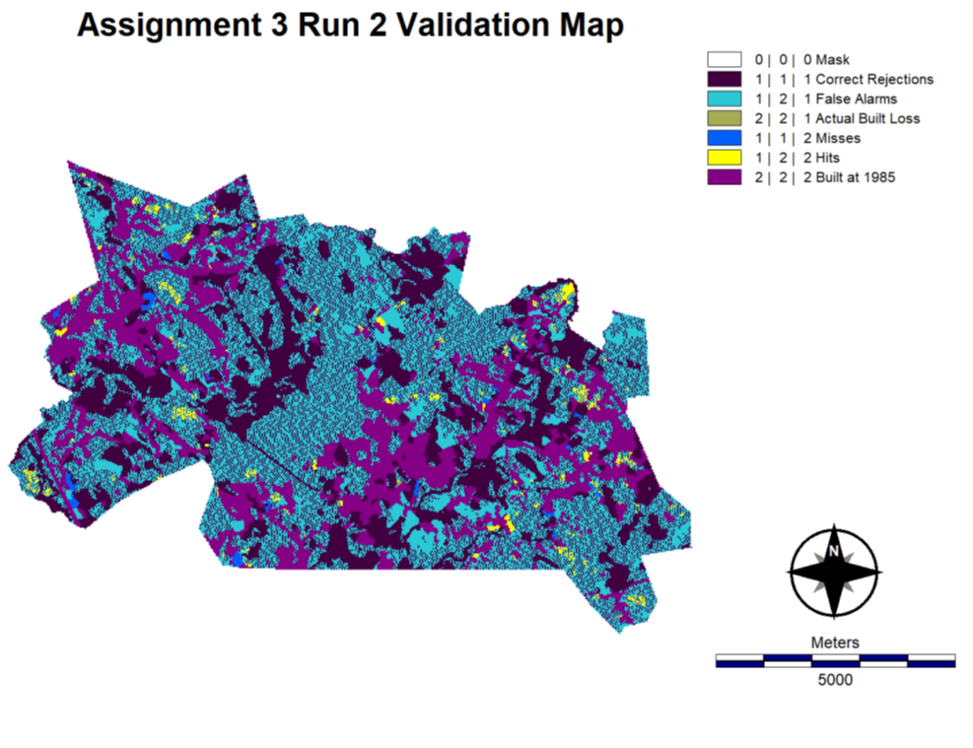
Run 2
In Run 2, I simulated a quantity equal to half the non-built area in the extent (a much larger quantity than Run 1), using GeoMod. Since this number is more than twice the actual quantity of pixels that experienced change, I knew before simulating that more than half the gain in built pixels in the 1999 simulation would be False Alarms.
Pixel Count by Category from the Validation Map (Run 2)
Category | Cells | Legend
0 | 158954 | 0 | 0 | 0 Mask
1 | 39276 | 1 | 1 | 1 Correct Rejections
2 | 38889 | 1 | 2 | 1 False Alarms
3 | 19 | 2 | 2 | 1 Actual Built Loss
4 | 1180 | 1 | 1 | 2 Misses
5 | 1566 | 1 | 2 | 2 Hits
6 | 22260 | 2 | 2 | 2 Built at 1985

Slide 11
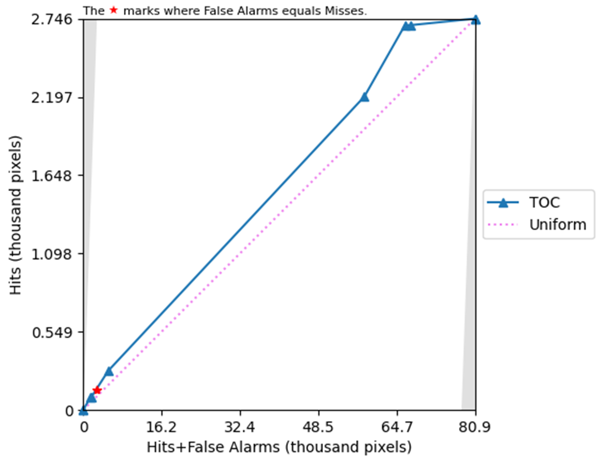
TOC CURVE – The upper-right figure is a Total Operating Characteristic [TOC] curve concerning the validation of suitability maps generated in the previous two slides (the two maps are identical). The curve describes the ability of the simulation to generate hits at different suitability levels. The dotted line describes the expected hits generated from a suitability map with random values at all pixels of expected gain. The curve is concerned with gain in built. Pixels that experience persistence in built are not part of the graph. The shaded triangles at the immediate left and right of the graph are areas outside the bounds of possible TOC curves.
The blue triangles symbolize a simulated gain equal to the pixels present in a particular land use
category (from the previous triangle). Read along the x-axis, we can see the various quantities of
each land use category that was given some suitability percentage x%<100%. GeoMod, as a greedy
algorithm, reads these percentages from largest to smallest. We can see these percentages in the
lower-right figure. The highest suitability land use category is Open Land. The highest suitability land
use category is always symbolized by the first triangle to the right of (0,0). The line extending from the
previous (to the left) triangle to this triangle encompasses the pixels in Open Land. The greater in magnitude the slope of a category, the more frequently it produces hits. After knowing how to read the graph, we can say that Forest (the largest quantity category in the graph) more frequently produces hits than Urban Open (first blue triangle to the left of the upper-right corner). Cropland more frequently yields hits than Forest.
assign3run1.lub
CATEGORY Suitability
1 Cropland 3.23 ▲
2 Pasture 7.09 ▲
3 Forest 4.06 ▲
4 Wetland 0.00
5 Mining 7.12 ▲
6 Open Land 12.07 ▲
7 Part. Recr. 0.00
8 Spec. Recr. 0.00
9 Wat. Recr. 0.00
10 Residential 1 100.00
11 Residential 2 100.00
12 Residential 3 100.00
13 Residential 4 100.00
14 Salt Wetland -1.00
15 Commercial 100.00
16 Industrial 100.00
17 Urban Open 1.91 ▲
18 Transportation 100.00
19 Waste Disposal 0.00
20 Water 0.00
21 Woody Perennial 0.00
0 -1.00
Stationarity is the reliability of a characteristic to maintain a certain pattern over different time points. Stationarity is something that identified by a researcher after identifying the pattern. For example, a land use time series may be viewed as nonstationary, but then later a pattern may be identified that reliably models the time series, at which point the time series could now be considered stationary. However, let’s use stationarity to mean a time series’ adherence to a model’s simulated suitability map. If we think about stationarity in this way, we can say that the data for 1999 landcover is not stationary with regards to the assignment three suitability map. This is because (for example) the land use category that was considered to have a higher suitability (forest) clearly generated hits less frequently than Cropland, a category that was considered to have a lower suitability by the suitability map. If the land use categories were correctly assigned their suitability scores, the TOC Curve would be composed of a series of land use categories consistently diminishing in magnitude of slope from left-to-right.

Slide 12
TOC curve for Assignment 3

Slide 13
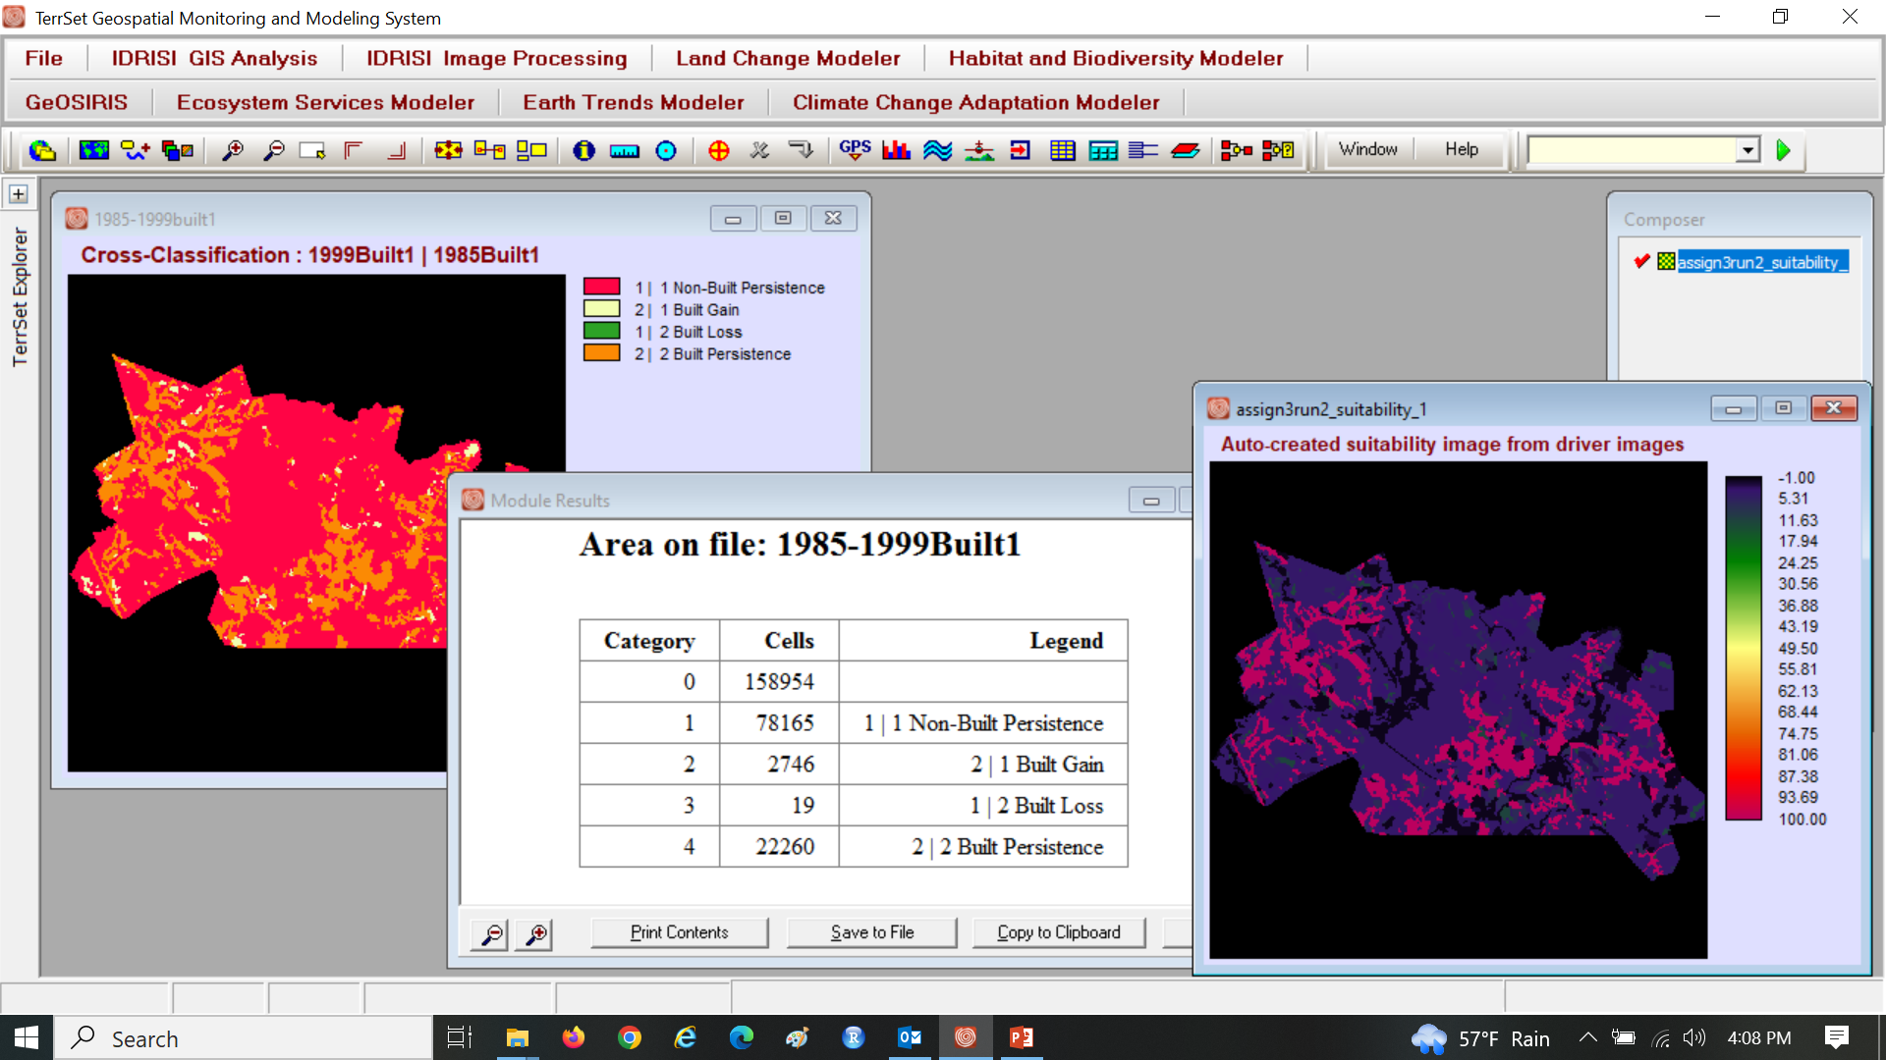
Built at 1985 are not candidates for gain of built after 1985, so the TOC curves masks out built at 1985. If we did not mask the pixels that were built at 1985, then how would have the TOC curve appeared?

Slide 14
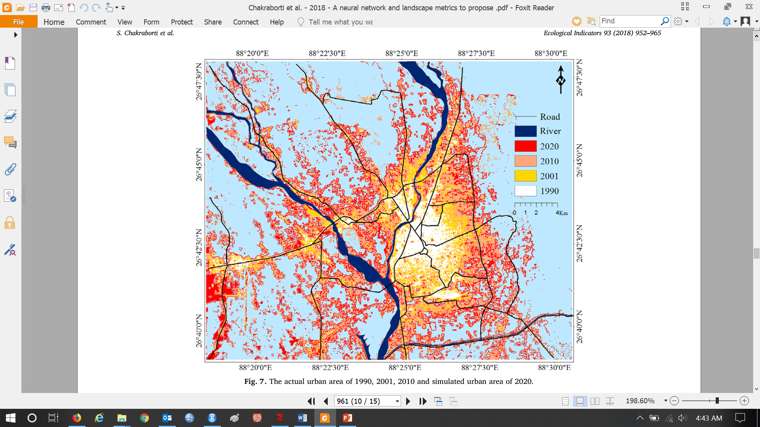
Chakraborti et al. (2018) A neural network and landscape metrics to propose a flexible urban growth boundary: A case study https://doi.org/10.1016/j.ecolind.2018.05.036

Slide 15
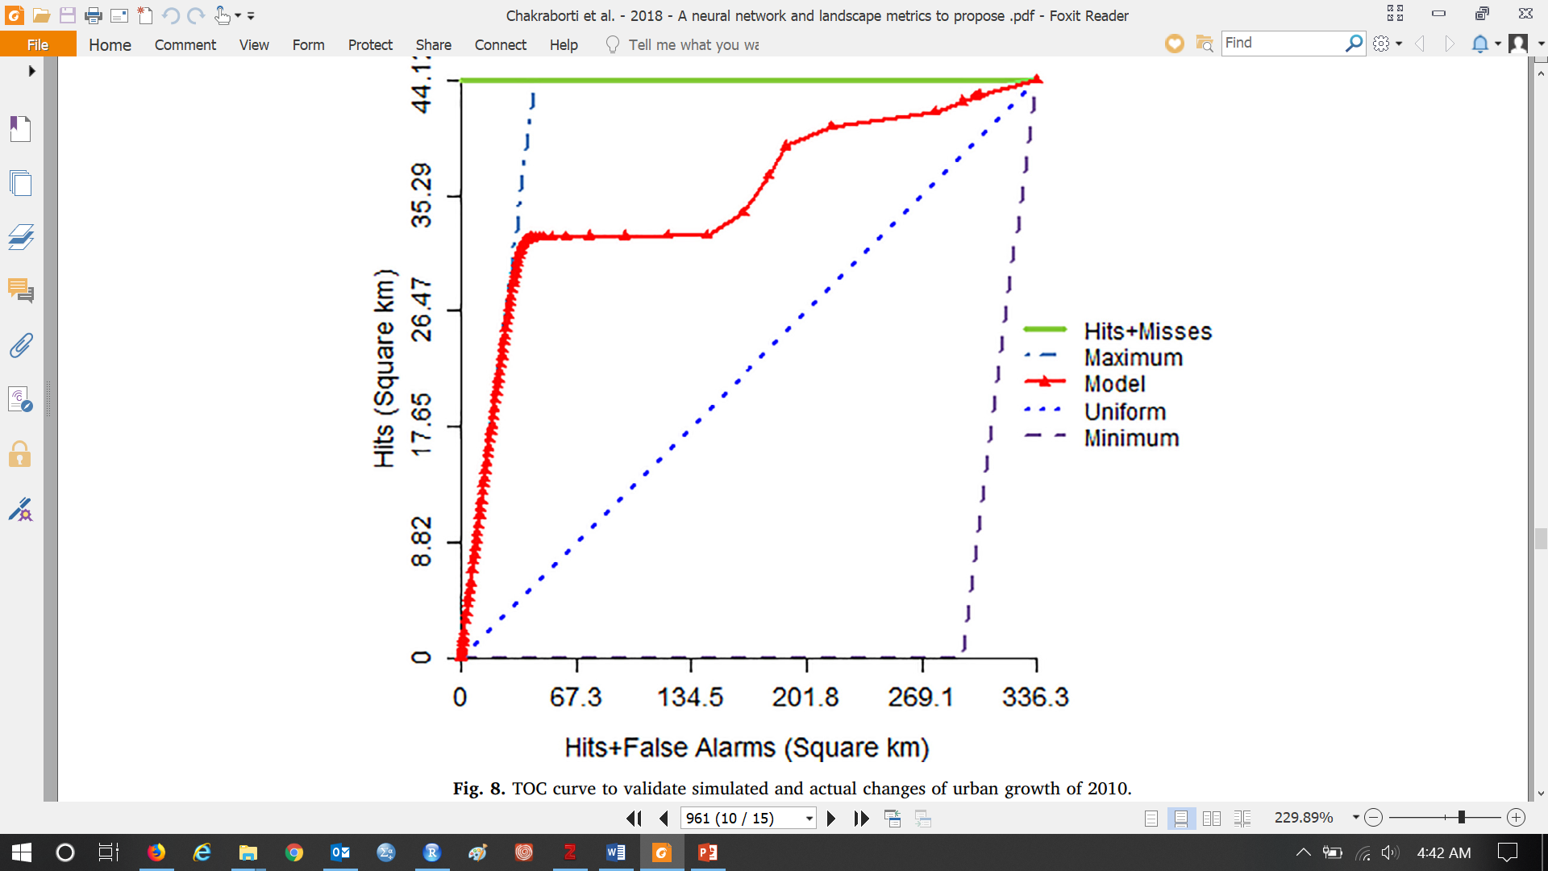
Chakraborti et al. (2018) Why is the curve on most of the left bound?

Slide 16
Pontius suspects the authors failed to mask the pixels that were already built at the start of the simulation. The large AUC indicates that the authors are skilled at predicting that built persists.

Slide 17
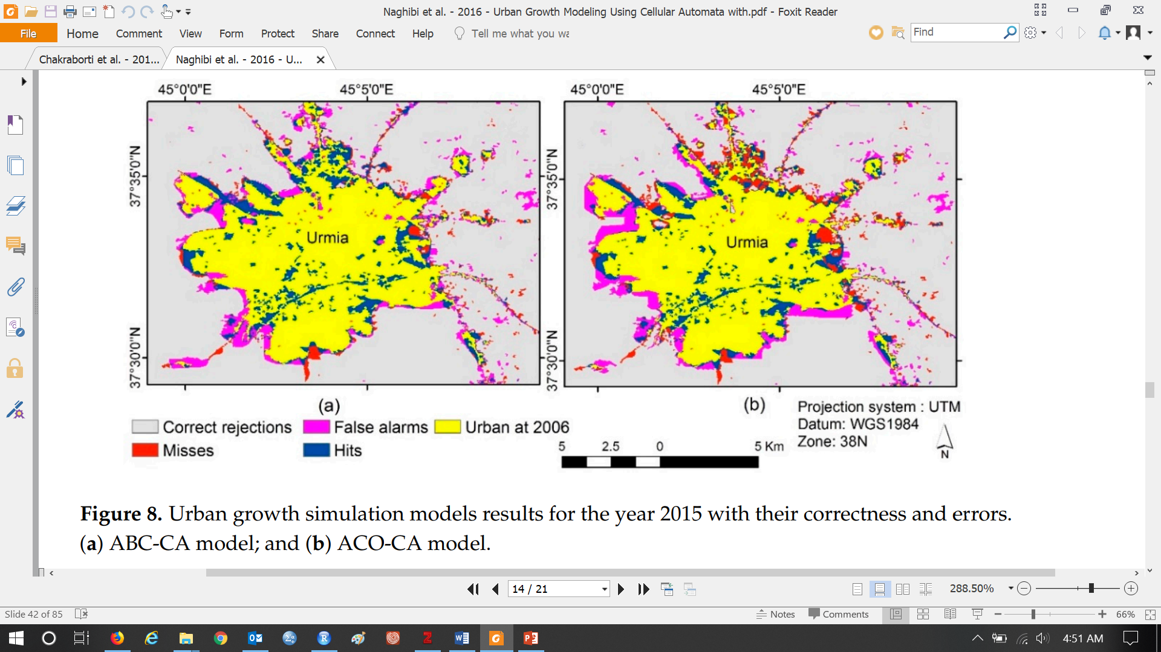
Naghibi and Delavar (2016) Urban Growth Modeling Using Cellular Automata with Multi-Temporal Remote Sensing Images Calibrated by the Artificial Bee Colony Optimization Algorithm

Slide 18
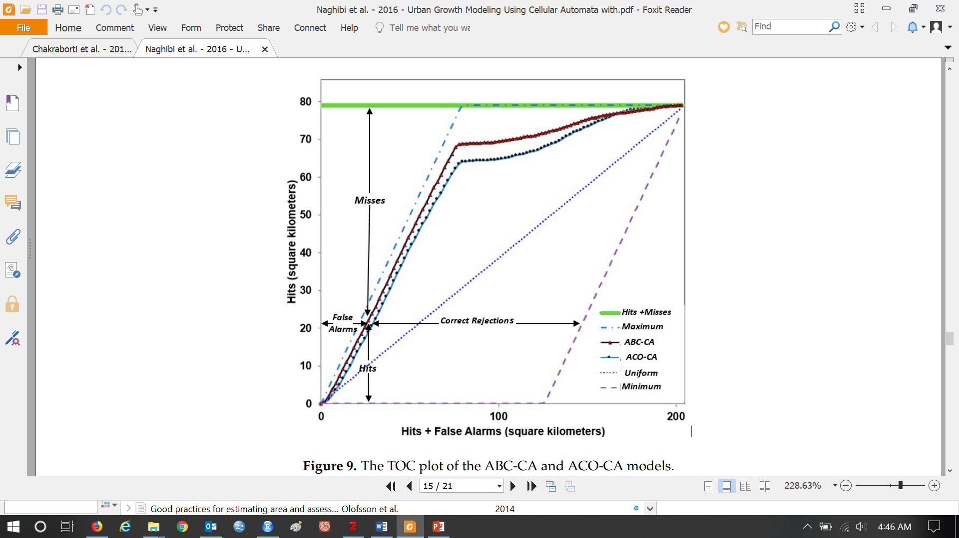
Naghibi and Delavar (2016) https://www.mdpi.com/2220-9964/5/12/241 How did they get curves so close to left bound? Why is there some separation between curve and left bound?

Slide 19
Pontius suspects the authors failed to mask the pixels that were already built. The separation indicates some loss of built.

Slide 20
Validation maps from CROSSTAB
Run 1
Run 2

Slide 21
Validation Maps from Land Change Modeler
Run 1
Run 2

Slide 22
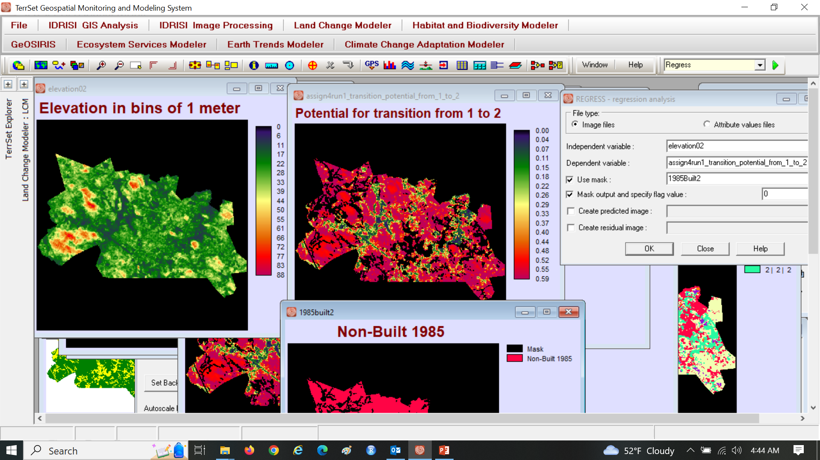
Assignment 4 REGRESS

Slide 23
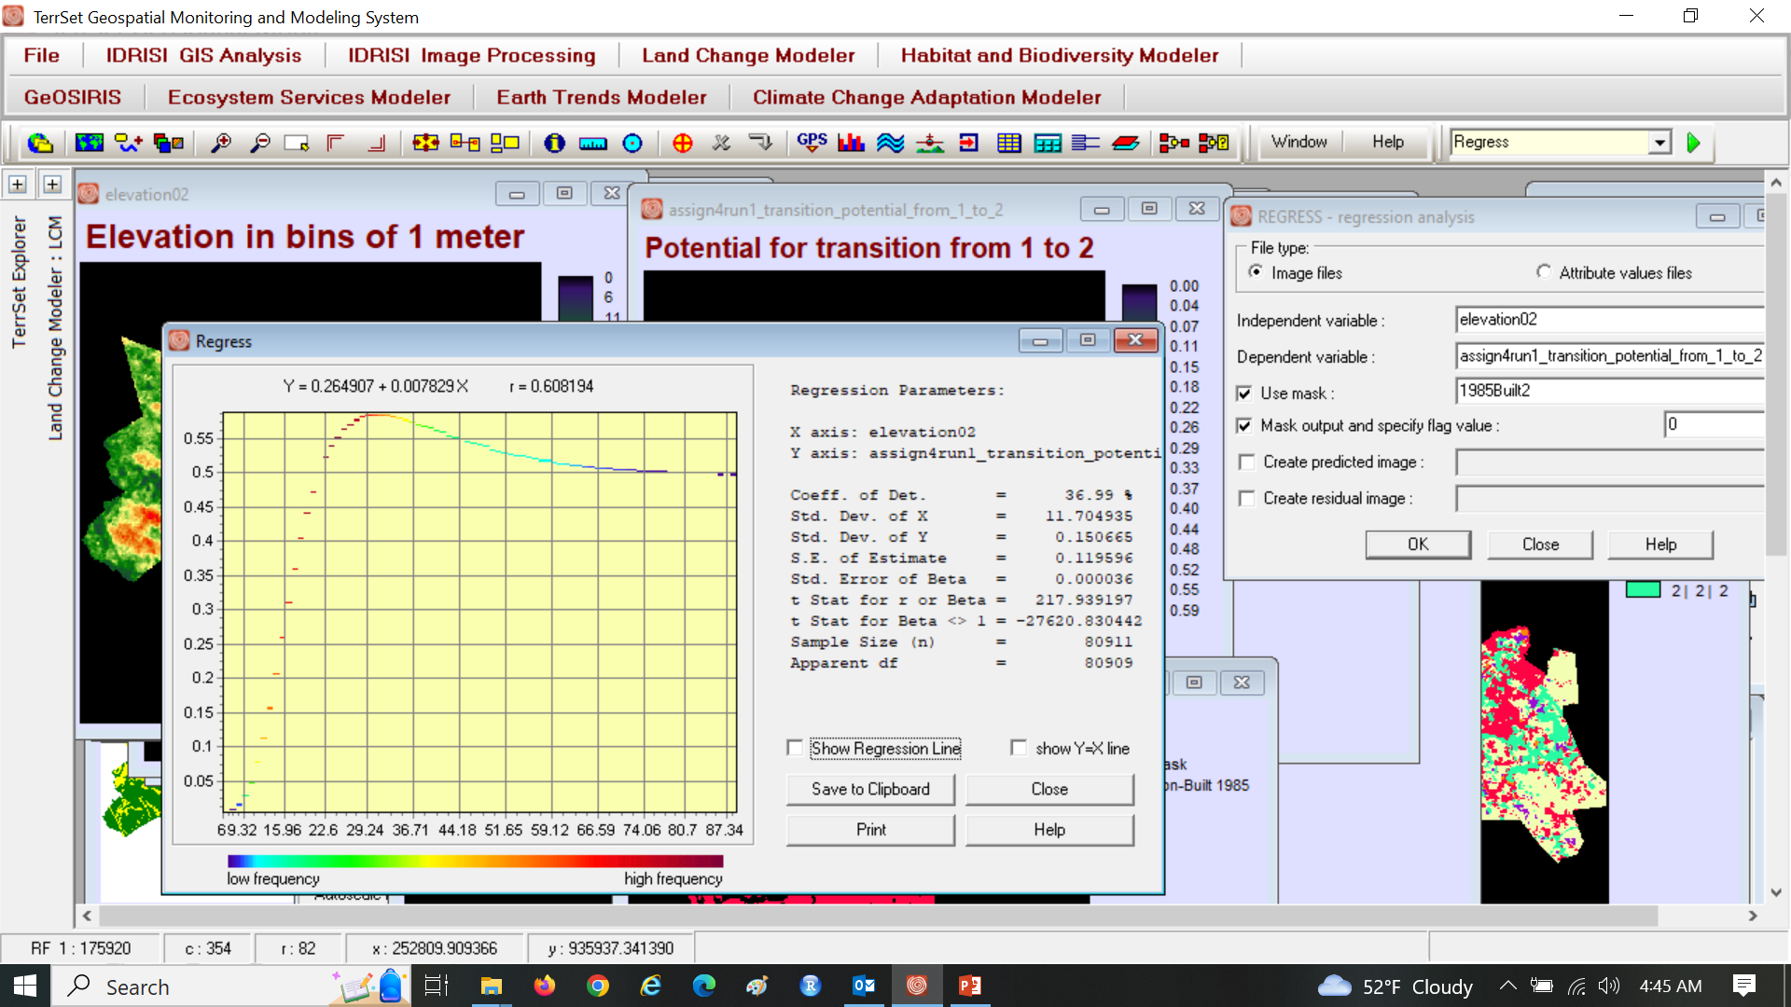
Assignment 4

Slide 24
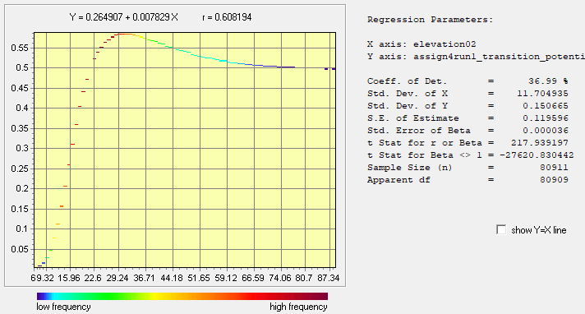
Largest transition potentials are on which elevations?

Slide 25
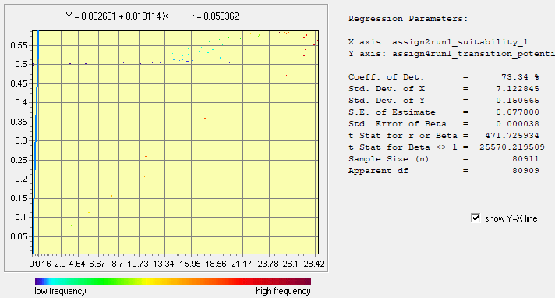
MLP transition potentials versus Geomod suitability values

Slide 26
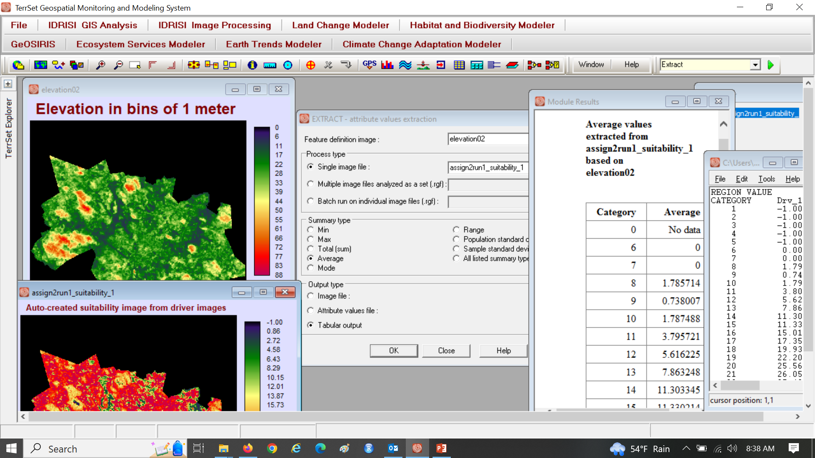
Get familiar with the EXTRACT module

Slide 27
Interpretation of transition potentials requires expertise.
What information did MLP have when it produced those transition potentials?
Is it possible that the transition potentials are probabilities of future land change?
How does LCM use those transition potentials to allocate the future land change?

Slide 28
Interpretation of transition potentials requires expertise.
What information did MLP have when it produced those transition potentials?
MLP knew all the pixels of built gain and a random sample of an equal number of non-built persistence during the calibration interval of 1971 to 1985.
MLP knew the elevation02 values of the pixels.
MLP knew neither the validation year nor then quantities from the Markov matrix.
Is it possible that the transition potentials are probabilities of future land change?
Pontius says no because of the answers to the previous question.
How does LCM use those transition potentials to allocate the future land change?
LCM uses the rank of transition potentials to dictate the sequence of pixels to simulate change in the same way Geomod uses suitability values.
The transition potentials are Vulnerabilities, which measures the relative conditions for change.
A transition potential of 0.5 means less than 0.6 and greater than 0.4.

